Slide 1
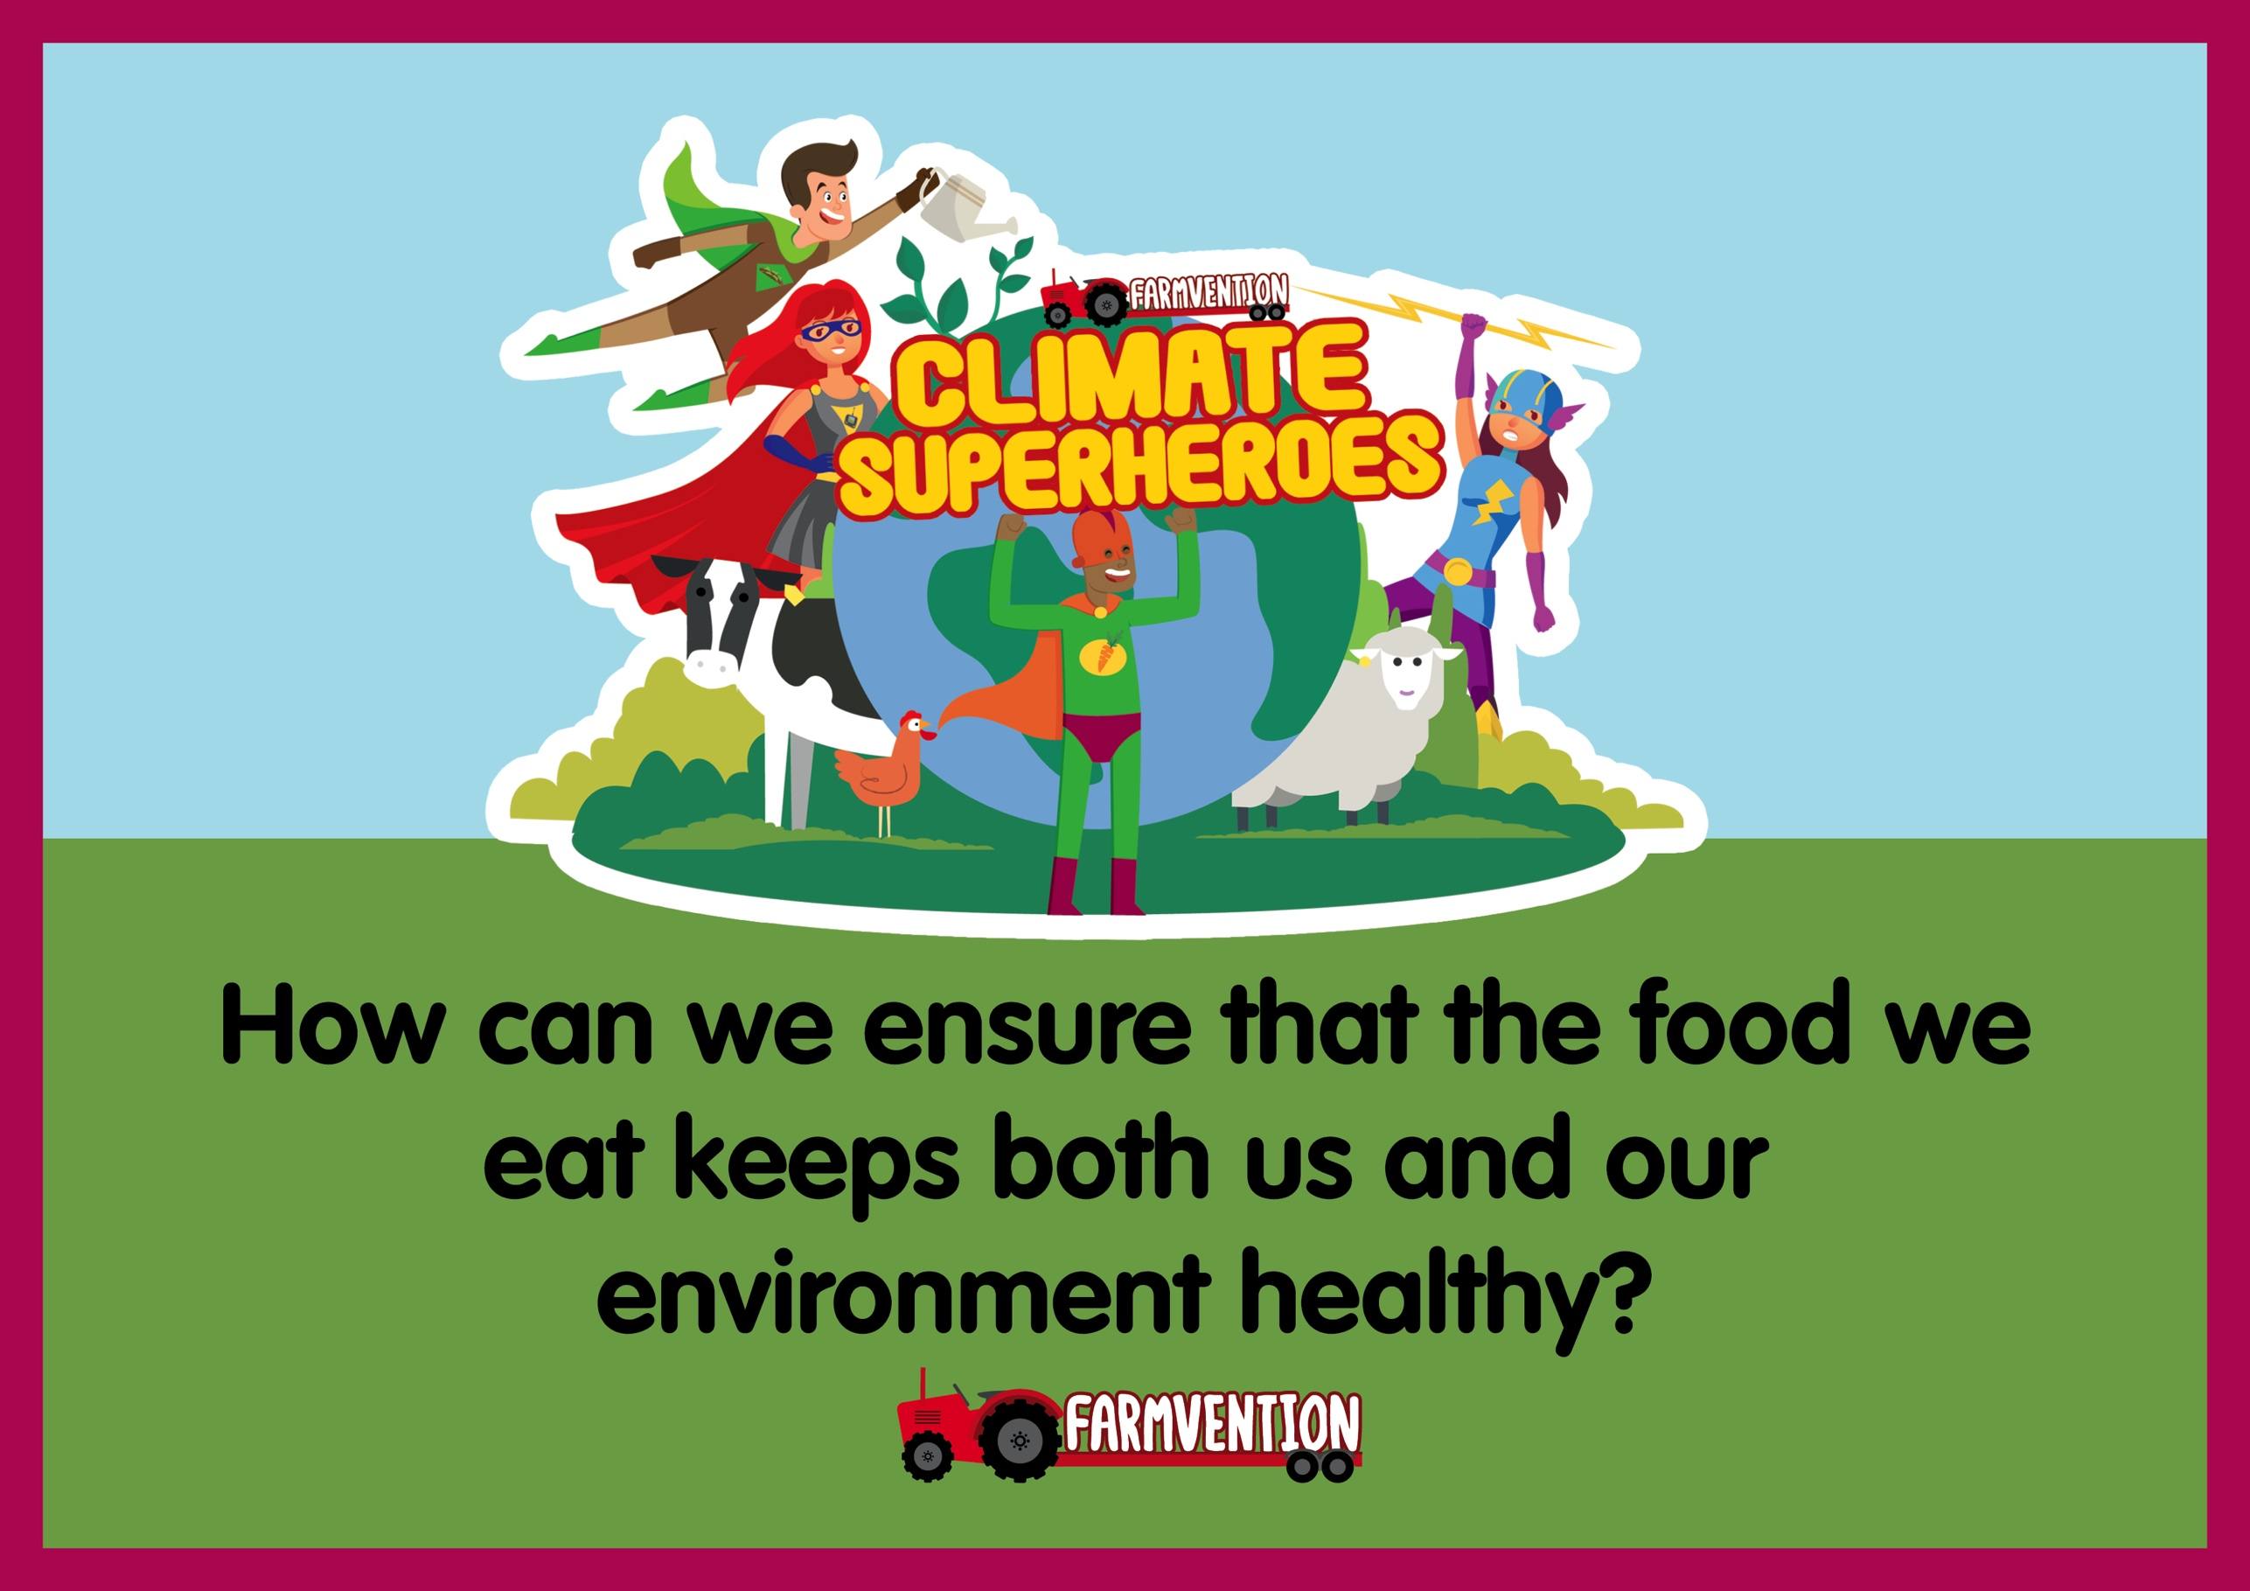
Notes:
Slide 1:
Landing Slide
Slide 2:
Seasonal Food
Slide 3:
Carbon footprints & out-of-season produce
Slide 4:
A healthy balanced diet
Slide 5:
Your challenge
Slide 6:
What did you find out and where could you take your investigation next?

Slide 2
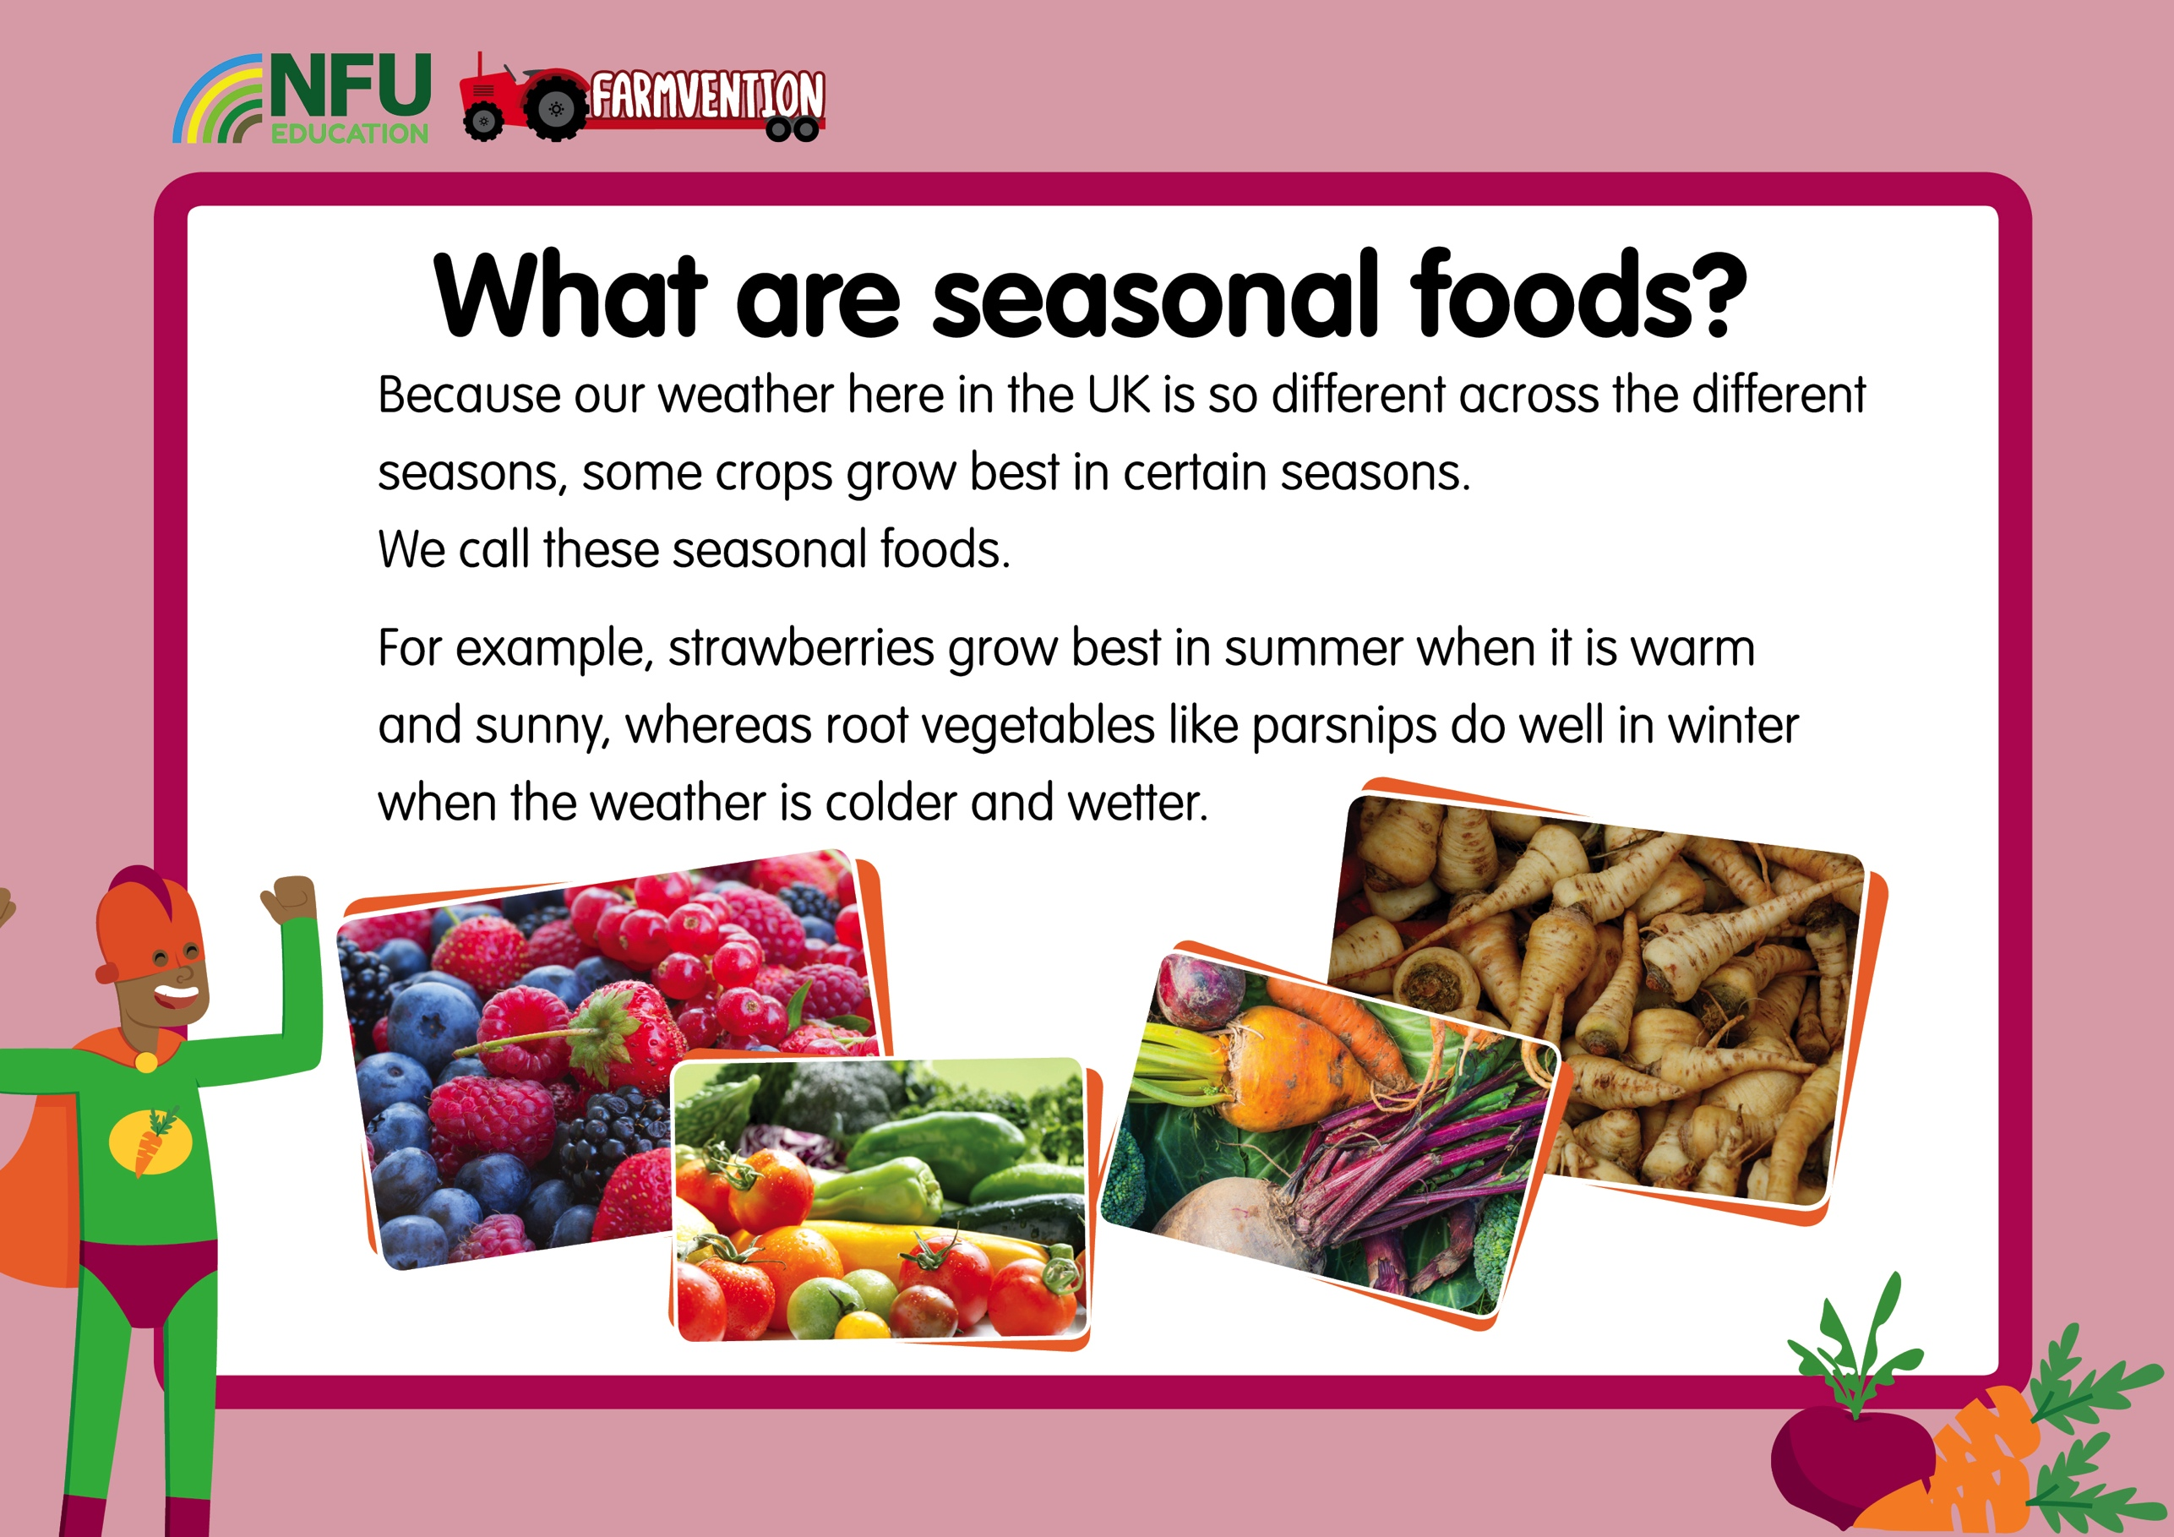
Notes:
Slide 2:
‘Seasonal foods’ are ones which grow in particular seasons based on the weather conditions in that season. Foods that are in season often taste better and they are usually cheaper than foods that aren’t in season, but there’s an even better reason to eat seasonally; it’s much better for the environment.
Some examples of seasonal foods in the UK include:
Spring – Apricots, cherries, , cucumber, new potatoes, spring onions, peppers, mushrooms, rocket, rhubarb
Summer – Blueberries, strawberries, tomatoes, aubergines, courgettes, sweetcorn, turnip
Autumn – Bramley apples, pears, beetroot, broccoli, celery, potatoes, pumpkin, turnips, parsnips, leeks
Winter – Cranberries, Brussels sprouts, clementines, shallots, cauliflower
Share the full list here: www.countrysideonline.co.uk/back-british-farming/cook-and-eat/the-great-british-larder/

Slide 3
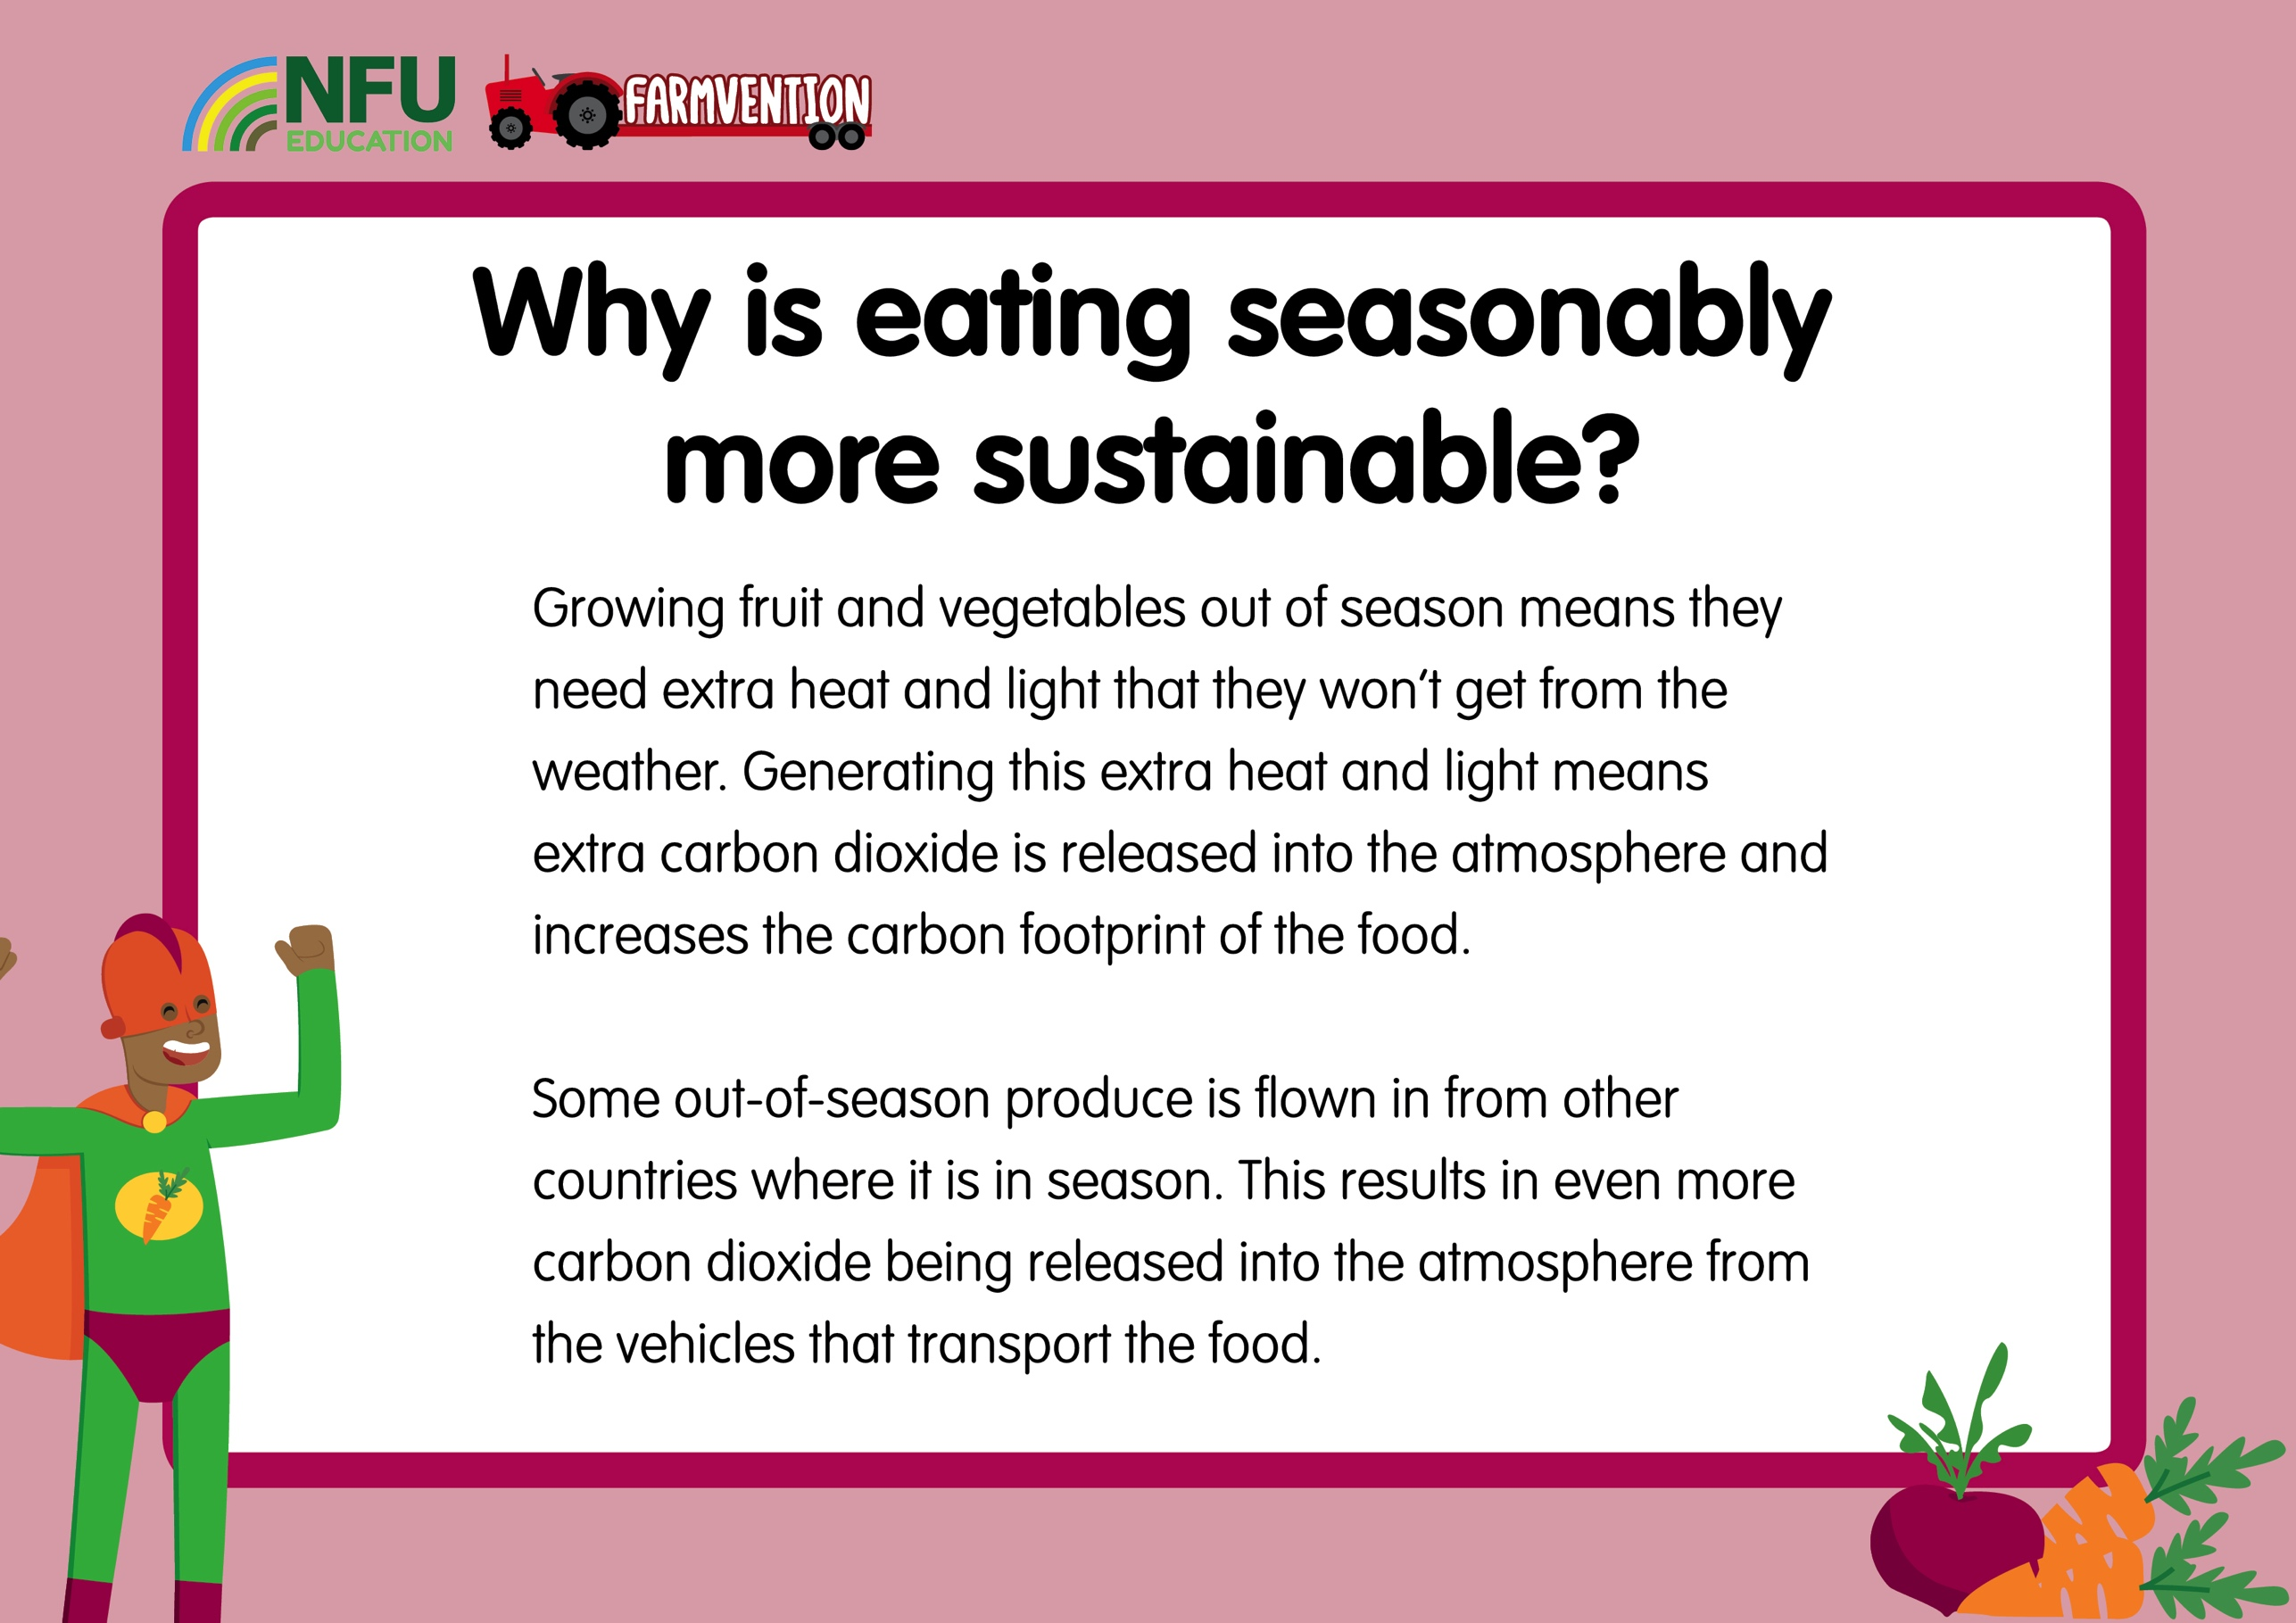
Notes:
Slide 3:
Growing fruit and vegetables out of season requires much more ‘artificial’ input, for examples strawberries grown in winter would need lots of heat and light that they wouldn’t get from the UK winter weather. This means that the carbon footprint of this out-of-season produce is much higher. A person’s (or product’s) carbon footprint is the amount of carbon dioxide their lifestyle (or journey to the consumer) contributes to the planet’s atmosphere.
Eating produce that is not in season in the UK could also increase the carbon footprint of your food due to some of this produce being flown in from other countries where it is in season. The term ‘food miles’ is used to describe how far food has travelled to get to the shops it is sold in, and increasing these food miles equates to an increase in pollution from the vehicles used to transport the food.
This video is a short introduction to the concept of food miles:
https://www.youtube.com/watch?v=b7rn5hH5XN8

Slide 4
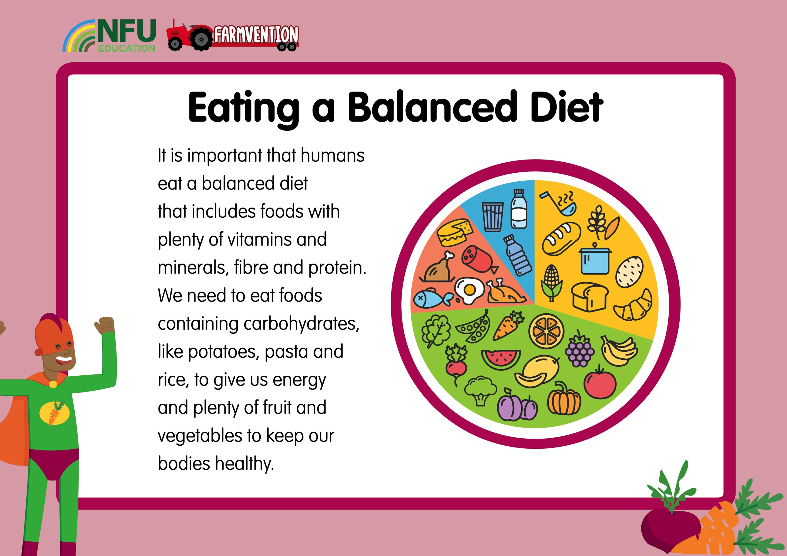
Image of a range of food and ideally some version of an Eatwell plate to show the balance between different food groups
Notes:
Slide 4:
Questions to pose to children:
Can you think of a food you really like that contains lots of protein?
Can you think of some foods that are high in fibre?
What nutrients were in your breakfast?
Why is it important not to eat too many foods that contain lots of fat or sugar?
Humans need to eat a balanced diet that includes protein, fibre, carbohydrates and vitamins and minerals. A good balance includes lots of fruit and vegetables (5-7 portions a day), some foods that contain protein such as red meat or kidney beans, some foods containing starchy carbohydrates such as rice, potatoes and pasta, some dairy products and a very small amount of foods that are high in fat or sugar. To remain healthy, we need lots of different vitamins and minerals that we get from our foods, such as vitamin C, calcium and iron.
Children often think that the term ‘diet’ refers to a low-calorie or low fat dieting plan followed in order to lose weight because of the way the word is commonly used. In science, ‘diet’ refers to everything a person or animal eats.

Slide 5
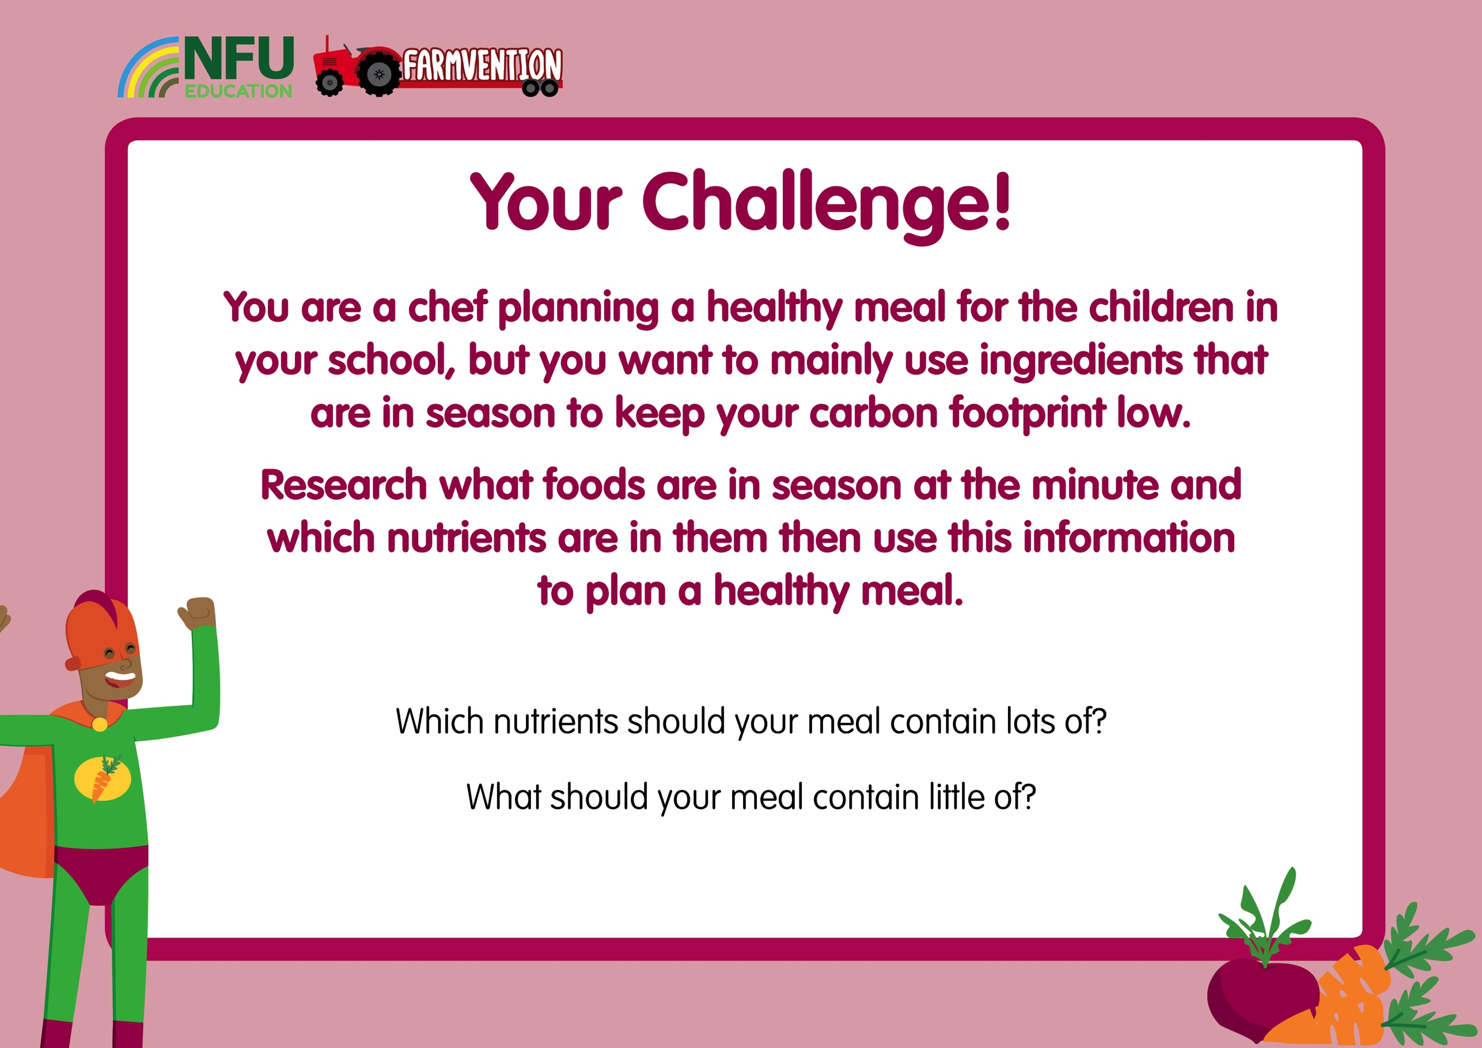
Notes:
Slide 5:
Questions to pose to children:
Which foods do you think are in season at the minute?
Where will we find information about which foods are in season?
This investigation will need to be carried out with the support of secondary sources – books and/or the internet. Alternatively, if you have access to a farm shop or local market, children could ask in person or send a family member or teacher with some questions to ask.
A good starting point would be to find out which of the foods they eat regularly are currently in season and which nutrients can be found in these. Children may come across foods that they are unfamiliar with, providing a great opportunity to try new foods if these are available.
Children could record their ideas by drawing a labelled picture of the meal, including the nutrients in it, by writing a recipe or by making their meal and taking photographs.
Health and Safety: Ensure children are closely supervised while preparing food, and that you model to correct techniques for potentially dangerous food preparation, such as chopping food or using appliances that are likely to be very hot or sharp.

Slide 6
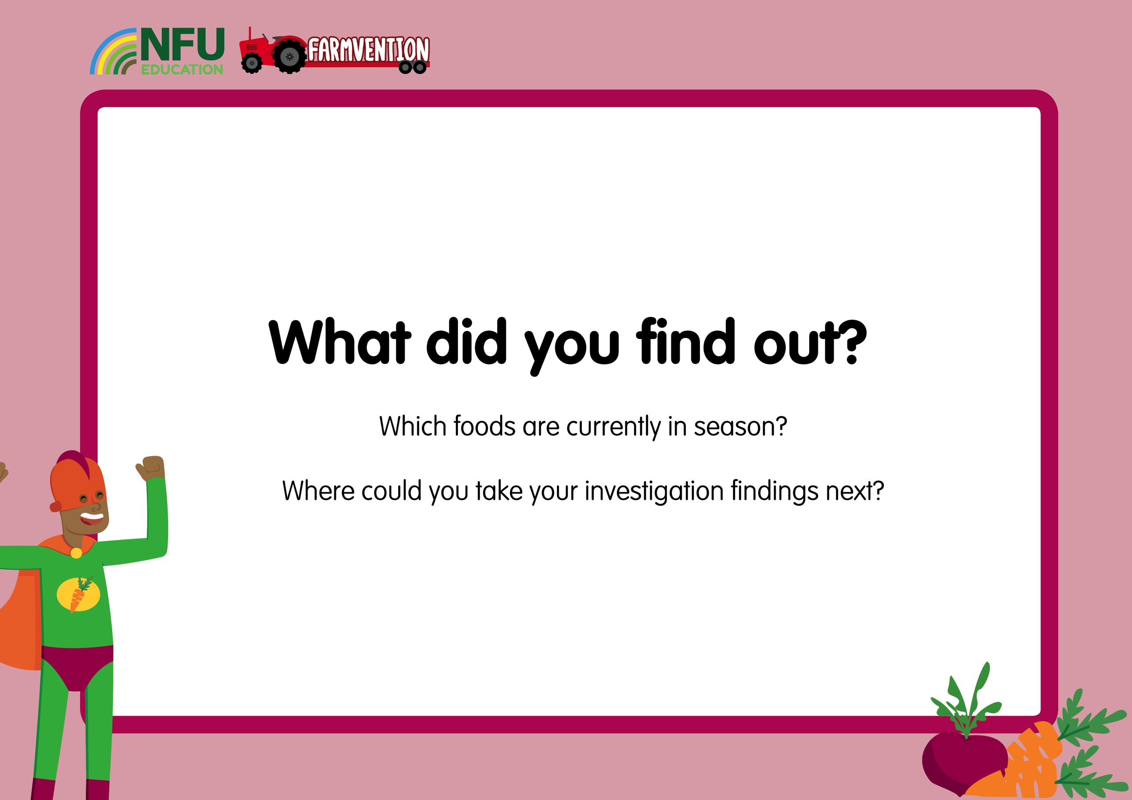
Notes:
Slide 6:
Questions to pose to children:
Where you surprised to see how many foods were in season? Did you think it would be more or less than it was?
Was it easy to plan a meal when your ingredients were limited?
What do you think the impact on the environment would be if you always ate seasonably? What if everyone ate seasonably?
Children could prepare and cook their meal for friends or family. They could design packaging for their meal, thinking about sustainable packaging materials and how to make it appear attractive to the target market (children or other school cooks). They could explore which foods are in season at different times of the year and plan a different meal. They could also research how seasons are different in different parts of the world and how this affects what crops can be grown, for example in countries around the equator it is hot all year round.

Slide 7
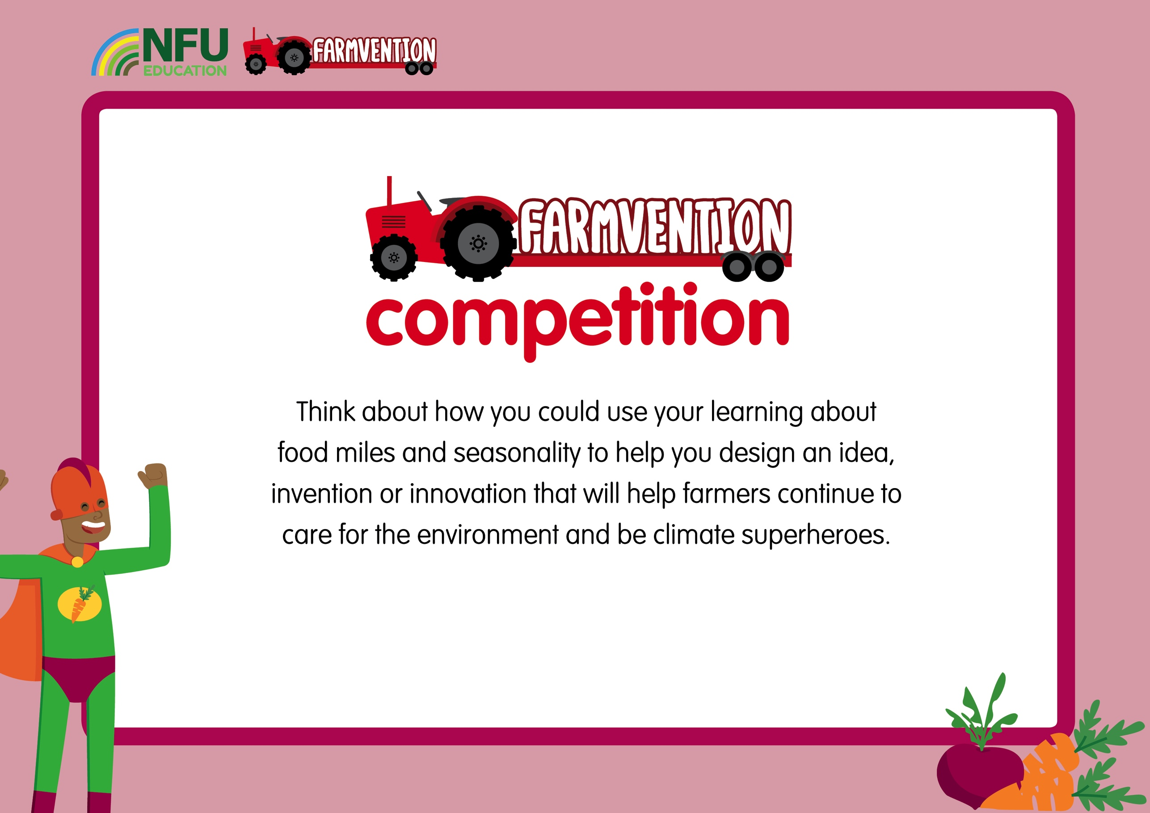
www.farmvention.com

